Slide 1
Movie review classification
BY:
Lohith DS
Nitinraj
Harsha N

Slide 2
Problem statement
The entertainment industry requires new and better ways to target specific users. This project explores the possibility of classifying the movie review corpus as positive or negative to help users to take better decisions.

Slide 3
Data set
02.
LIBRARIES
01.
03.
Machine learning model
design
IMDB Dataset which has 50,000 reviews
NumPy, matplotlib, pandas, re, nltk, sklearn
Support vector machine algorithm

Slide 4
Implementation details
We chose Imdb dataset which has over 50k review with 25k positive and 25k negative.
Then we cleaned the dataset by removing punctuation marks,stopwords,converted into lower case and used stemming .
Then we split our dataset into training and test set.
After that we trained our model using training set .
Then we tested our model with unseen dataset which is test set and determined the accuracy
We also tested the model with new reviews manual giving input.
Then we evaluated the model using confusion matrix, precision and recall

Slide 5
Conclusion And challenges faced
Conclusion: We are able to classify movie reviews using machine learning with good accuracy
Challenges faced:
Since we beginners to Machine learning its was difficult to understand lot of stuff at the start.
Figuring how to classify reviews to positive and negative.
What are all the features we need to extract from a review to classify its response
Since there are lots of Machine learning model we were not sure which to choose.
Big challenge we faced was time since we needed to manage both class and project work

Slide 6
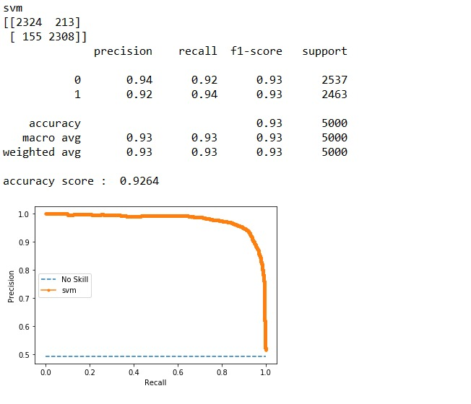

Precision recall curve
The precision-recall curve shows the tradeoff between precision and recall for different threshold.
A high area under the curve represents both high recall and high precision, where high precision relates to a low false positive rate, and high recall relates to a low false negative rate.

Slide 7
references
Nltk book which had a most of the necessary information to implement the project.
Kaggle website for dataset
Along with Nltk book we searched for research papers,github and Youtube videos for reference

Slide 8
Q & A

Slide 9
THANKS

